Slide 1

Experience Sharing
Please imagine an interesting experience you once paid money to enjoy…
Experience
Sharing

Slide 2

Now, imagine how great it would have been if you had raised money for your favorite cause
at the same time!

Slide 3
The Problem:
Nonprofits are overwhelmed!
Fundraising takes a lot of time, and…
Not much money is raised for the
amount of time & effort invested!

Slide 4
Our Solution:
We offer unique experiences that raise funds for nonprofit causes in a way that is
Fast, Fun, Meaningful, Social and…
Builds Community
Participate in UNIQUE experiences!
Help raise funds for AMAZING causes!

Slide 5
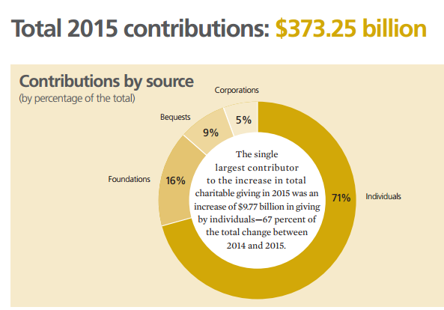
The Opportunity
Source: Giving USA Highlights: An Overview of Giving in 2015

Slide 6
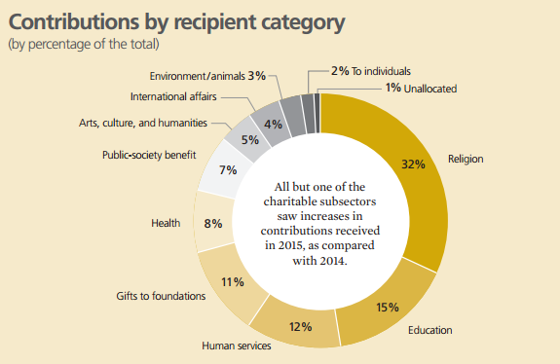
The Opportunity:
Source: Giving USA Highlights: An Overview of Giving in 2015

Slide 7
Target Customers, Users &
Go to Market Strategy
Corporations seeking to promote social responsibility / increase brand awareness
Nonprofit organizations seeking funds to fulfill their mission
Individuals looking for opportunities to donate & help their favorite causes

Slide 8
Unique Value Propositions
We provide fast, year-round/non-seasonal fundraising through a solid crowdfunding platform
We help increase awareness of a nonprofit’s cause & a company’s brand & creates community goodwill
Increase the pool of charitable givers by inspiring first time donors

Slide 9
Competition
CharityBuzz (focused on celebrity meet&greets and auction of high ticket items)
Winspire (auction-based fundraising, average experience cost $2,000)
Time consuming, not very effective charity events

Slide 10
Key Partners
Socially Responsible Corporations
Social Media Influencers
Nonprofits & Community Groups
Altruistic Individuals who Offer Experiences

Slide 11
Cost structure
BUSINESS MODEL
Website Maintenance (Free Domain Hosting & Bandwidth)
Payroll is Minimal (Our solution is not labor intensive)
Cost for Acquiring Users (Leverage Free Social Media)
Revenue Streams
Percentage of Donated Funds Raised (Kickstarter)
Corporate Logo / Sponsor Advertising
Donations Gratefully Accepted
Future Revenue Streams
Premium Paid for Featured Experiences
Affiliate Marketing (Amazon Smiles)

Slide 12
Product Demo
[INSERT SCREENSHOTS OF WEBSITE AND STEP-BY-STEP DESCRIPTION OF USER INTERFACE]

Slide 13
Experience Sharing
A collaborative project by our team:
Victoria Franks – Design/Legal
Sean Walker – UI Developer
Leandro Schuab – UI Developer
Clare Rhoads – Business/Nonprofit
Sagar Navgire – Backend Developer

Slide 14
Fundraising that is
Fast
Fun
Meaningful
Social, and…
Builds Community
Questions?

